Slide 1
Design and Analysis of Algorithm Dynamic Programming (Longest Common Subsequence)
Lecture – 57

Slide 2
Overview
Dynamic Programming is a general algorithm design technique for solving problems defined by recurrences with overlapping subproblems
Invented by American mathematician “Richard Bellman) in the year 1950s to solve optimization problems and later assimilated by Computer Science.
“Programming” here means “planning”

Slide 3
Dynamic Programming
“Method of solving complex problems by breaking them down into smaller sub-problems, solving each of those sub-problems just once, and storing their solutions.”
The problem solving approach looks like Divide and conquer approach.(which is not true)

Slide 4
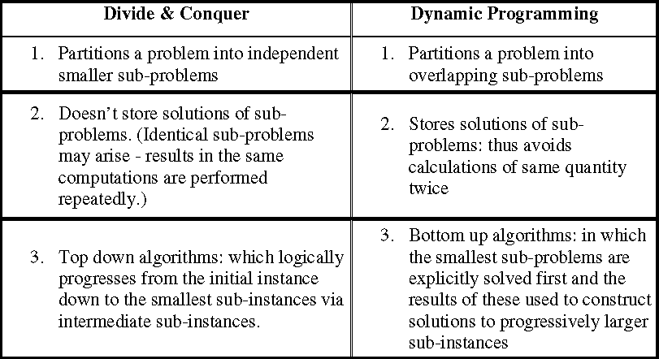
Dynamic Programming
Difference between Dynamic programming and Divide and Conquer approach.

Slide 5
Dynamic Programming
Is a Four-step methods
1. Characterize the structure of an optimal solution.
2. Recursively define the value of an optimal solution.
3. Compute the value of an optimal solution, typically in a bottom-up fashion.
4. Construct an optimal solution from computed information.

Slide 6
Dynamic Programming
Problems:
1. 0/1 Knapsack Problem
Floyd-Warshall Algorithm
Longest Common Sub-sequence
Matrix Chain Multiplication

Slide 7
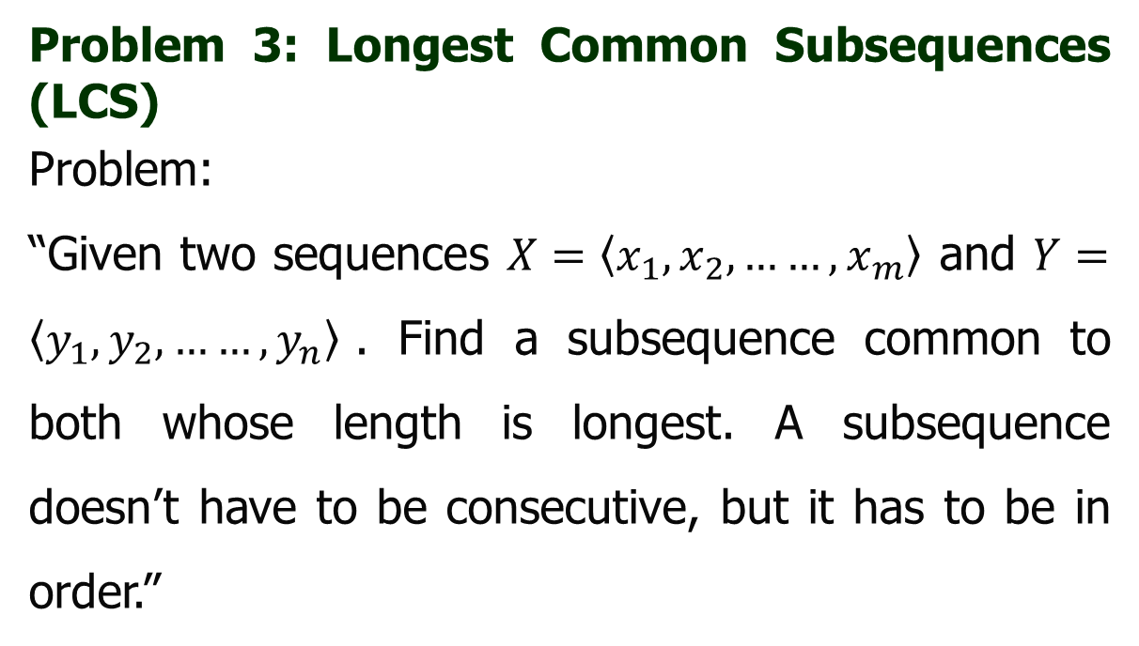
Dynamic Programming
Problem 3: Longest Common Subsequences (LCS)
Problem:
“Given two sequences $X=\left\langle x_{1},x_{2},……,x_{m}\right\rangle$ and $Y=\left\langle y_{1},y_{2},……,y_{n}\right\rangle$. Find a subsequence common to both whose length is longest. A subsequence doesn’t have to be consecutive, but it has to be in order.”

Slide 8




Dynamic Programming
Problem 3: Longest Common Subsequences (LCS)
Example:
S p r i n g t i m e
h o r s e b a c k
p i o n e e r
s n o w f l a k e
$$LCS :p i n e$$
$$LCS :o a k$$
m a e l e s t r o m
h e r o i c a l l y
b e c a l m
s c h o l a r l y
$$LCS :e l m$$
$$LCS :h o l l$$

Slide 9
Dynamic Programming
Problem 3: Longest Common Subsequence
It is used, when the solution can be recursively described in terms of solutions to subproblems (optimal substructure)
Algorithm finds solutions to subproblems and stores them in memory for later use
More efficient than “brute-force methods”, which solve the same subproblems over and over again

Slide 10
Dynamic Programming
Problem 3: Longest Common Subsequence
Application: comparison of two DNA strings
Example: X= {A B C B D A B }, Y= {B D C A B A}
Longest Common Subsequence:
X = A B C B D A B
Y = B D C A B A
Brute force algorithm would compare each subsequence of X with the symbols in Y

Slide 11
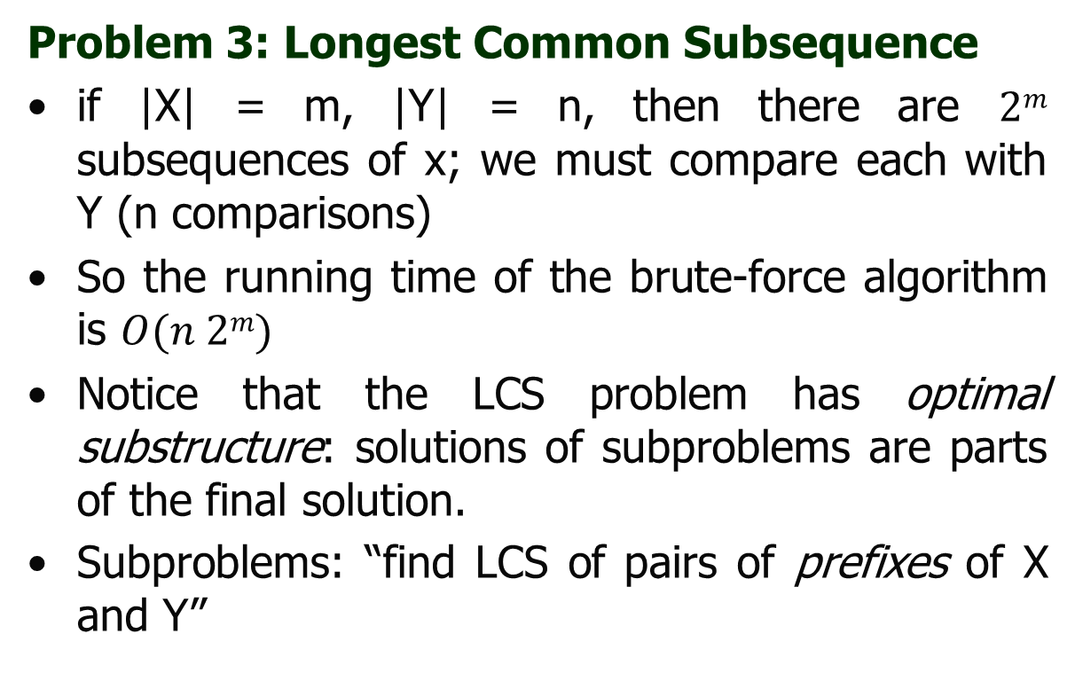
Dynamic Programming
Problem 3: Longest Common Subsequence
if |X| = m, |Y| = n, then there are $2m$ subsequences of x; we must compare each with Y (n comparisons)
So the running time of the brute-force algorithm is $O(n 2m)$
Notice that the LCS problem has optimal substructure: solutions of subproblems are parts of the final solution.
Subproblems: “find LCS of pairs of prefixes of X and Y”

Slide 12
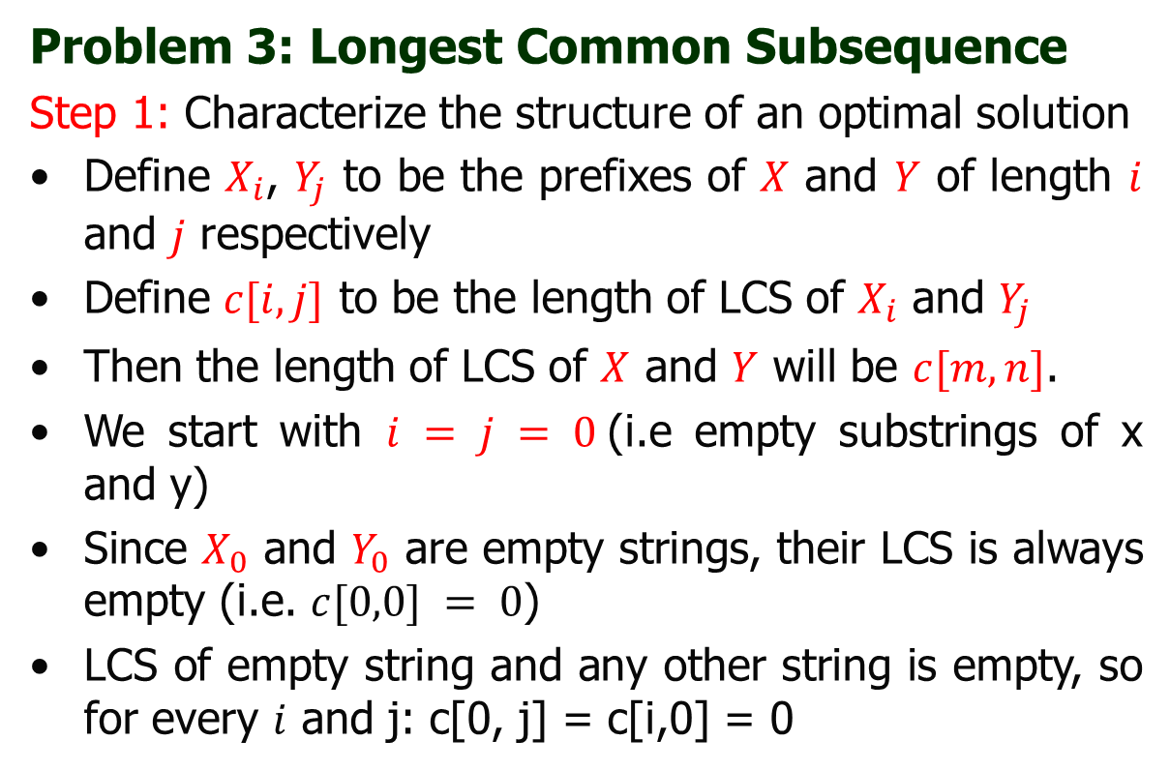
Dynamic Programming
Problem 3: Longest Common Subsequence
Step 1: Characterize the structure of an optimal solution
Define $X_{i}$, $Y_{j}$ to be the prefixes of $X$ and $Y$ of length $i$ and $j$ respectively
Define $c[i,j]$ to be the length of LCS of $X_{i}$ and $Y_{j}$
Then the length of LCS of $X$ and $Y$ will be $c[m,n]$.
We start with $i = j = 0$(i.e empty substrings of x and y)
Since $X_{0}$ and $Y_{0}$ are empty strings, their LCS is always empty (i.e. $c[0,0] = 0$)
LCS of empty string and any other string is empty, so for every $i$ and j: c[0, j] = c[i,0] = 0

Slide 13
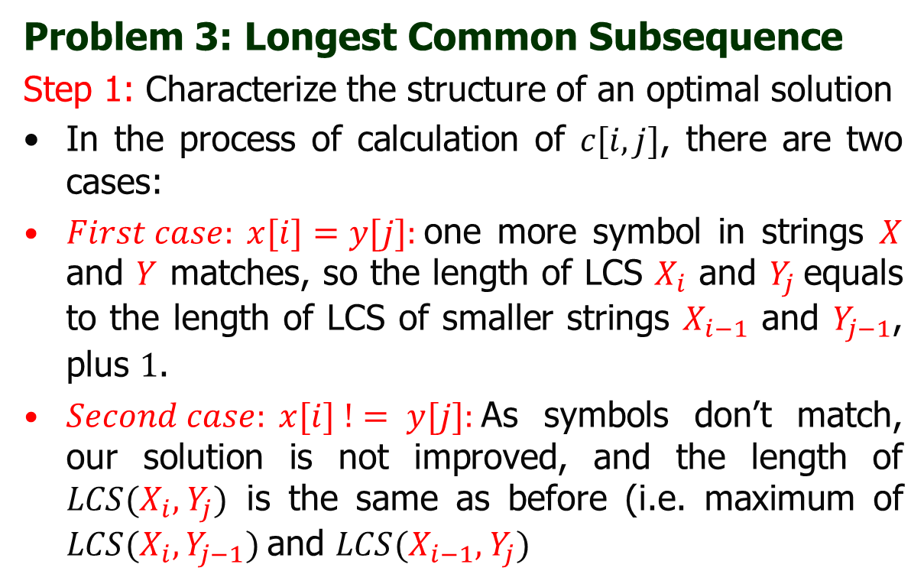
Dynamic Programming
Problem 3: Longest Common Subsequence
Step 1: Characterize the structure of an optimal solution
In the process of calculation of $c[i,j]$, there are two cases:
$First case: x[i]=y[j]:$one more symbol in strings $X$ and $Y$ matches, so the length of LCS $X_{i}$ and $Y_{j}$equals to the length of LCS of smaller strings $X_{i−1}$ and $Y_{j−1}$, plus $1$.
$Second case: x[i] != y[j]:$As symbols don’t match, our solution is not improved, and the length of $LCS(X_{i}\text{, }Y_{j})$ is the same as before (i.e. maximum of $LCS(X_{i}, Y_{j−1})$and $LCS(X_{i−1}\text{, }Y_{j})$

Slide 14
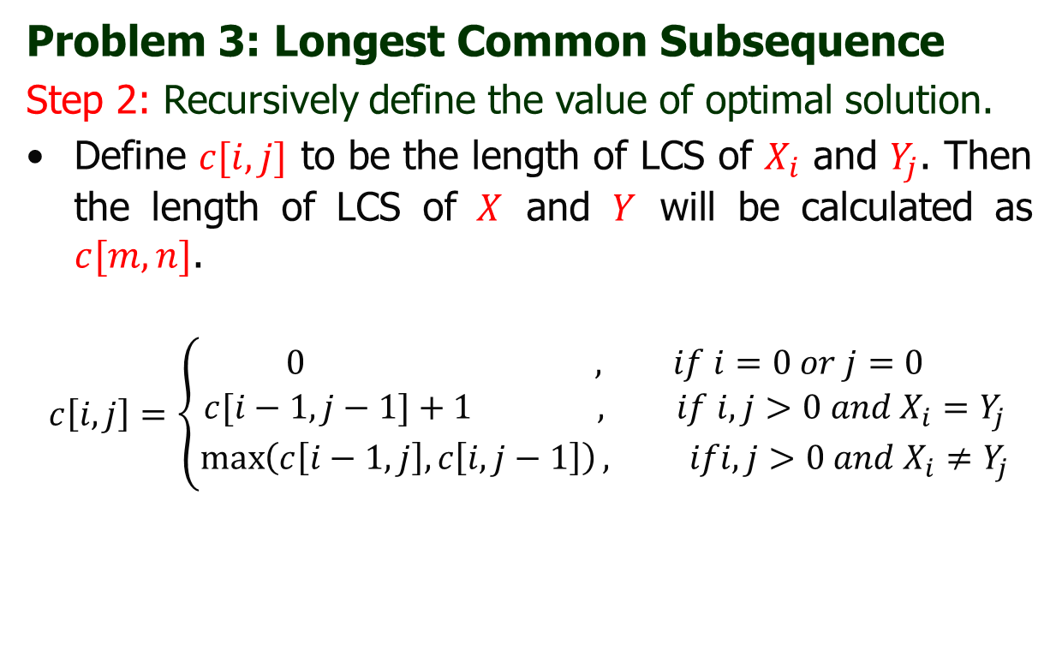
Dynamic Programming
Problem 3: Longest Common Subsequence
Step 2: Recursively define the value of optimal solution.
Define $c[i,j]$ to be the length of LCS of $X_{i}$ and $Y_{j}$. Then the length of LCS of $X$ and $Y$ will be calculated as $c[m,n]$.
$$c\left[i,j\right]=\left\{\begin{aligned}0 , if i=0 or j=0 \\ &c[i−1,j−1]+1 , if i,j>0 and{ X}_{i}=Y_{j} \\ \max\left(c\left[i−1,j\right], c\left[i,j−1\right]\right), ifi,j>0 and{ X}_{i}≠Y_{j}\end{aligned}\right.$$

Slide 15
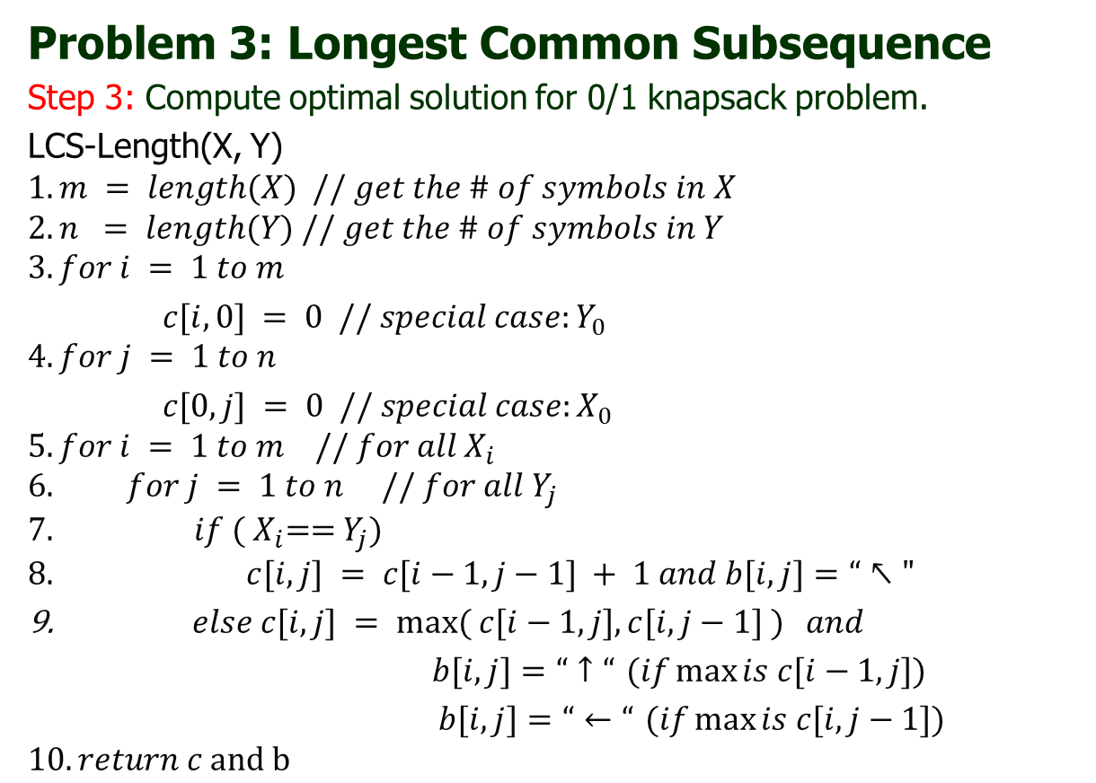
Dynamic Programming
Problem 3: Longest Common Subsequence
Step 3: Compute optimal solution for 0/1 knapsack problem.
LCS-Length(X, Y)
$$1. m = length(X) // get the \# of symbols in X$$
$$2. n = length(Y) // get the \# of symbols in Y$$
$$3. for i = 1 to m$$
$c[i,0] = 0 // special case:Y_{0}$
$$4. for j = 1 to n$$
$c[0,j] = 0 // special case:X_{0}$
$$5. for i = 1 to m // for all{ X}_{i}$$
$$6. for j = 1 to n // for all{ Y}_{j}$$
$$7. if ({ X}_{i}=={ Y}_{j})$$
$$8. c[i,j] = c[i−1,j−1] + 1 and b[i, j]=“↖"$$
$else c[i,j] = max⁡( c[i−1,j], c[i,j−1] )$ $and$
$b[i, j]=“↑“$ $(if\max{is c[i−1,j])}$
$b[i, j]=“←“$ $(if\max{is c[i,j−1])}$
$$10. return c and b$$

Slide 16
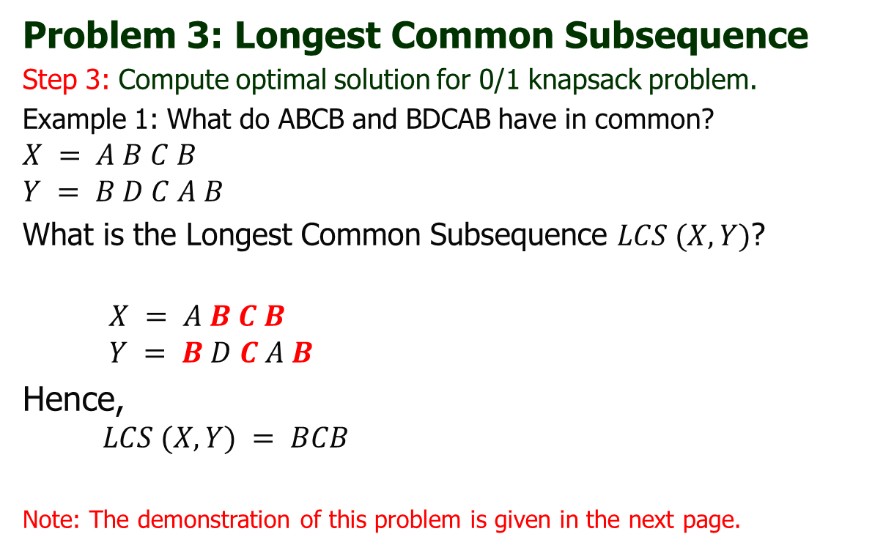
Dynamic Programming
Problem 3: Longest Common Subsequence
Step 3: Compute optimal solution for 0/1 knapsack problem.
Example 1: What do ABCB and BDCAB have in common?
$$X = A B C B$$
$$Y = B D C A B$$
What is the Longest Common Subsequence $LCS (X, Y)$?
$$X = A B C B$$
$$Y = B D C A B$$
Hence,
$$LCS (X, Y) = BCB$$
Note: The demonstration of this problem is given in the next page.

Slide 17
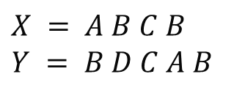
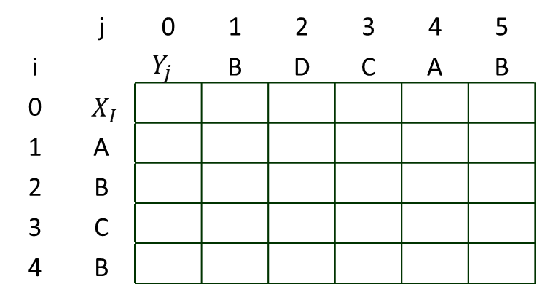
Dynamic Programming
Problem 3: Longest Common Subsequence
Step 3: Compute optimal solution for 0/1 knapsack problem.
Example 1: What do ABCB and BDCAB have in common?
 | j | 0 | 1 | 2 | 3 | 4 | 5
i |  | $$Y_{j}$$ | B | D | C | A | B
0 | $${ X}_{I}$$
1 | A
2 | B
3 | C
4 | B
$$X = A B C B$$
$$Y = B D C A B$$
X = ABCB; m = |X| = 4
Y = BDCAB; n = |Y| = 5
Allocate array c[5,6]

Slide 18
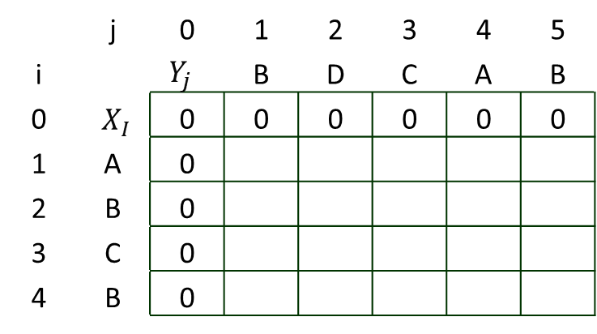
Dynamic Programming
Problem 3: Longest Common Subsequence
Step 3: Compute optimal solution for 0/1 knapsack problem.
Example 1: What do ABCB and BDCAB have in common?
 | j | 0 | 1 | 2 | 3 | 4 | 5
i |  | $$Y_{j}$$ | B | D | C | A | B
0 | $${ X}_{I}$$ | 0 | 0 | 0 | 0 | 0 | 0
1 | A | 0
2 | B | 0
3 | C | 0
4 | B | 0
$$X = A B C B$$
$$Y = B D C A B$$
for i = 0 to m c[i,0] = 0
for j = 1 to n c[0,j] = 0

Slide 19
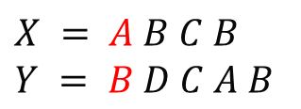
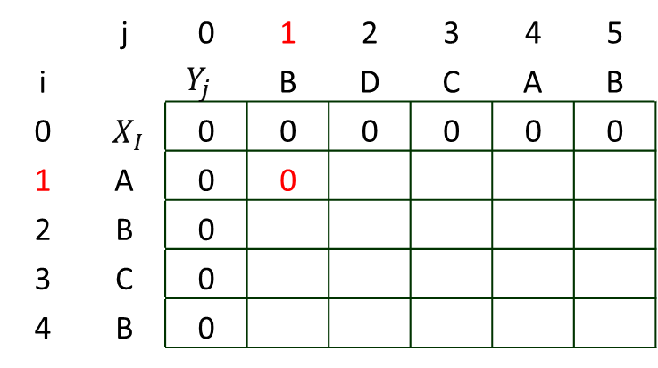
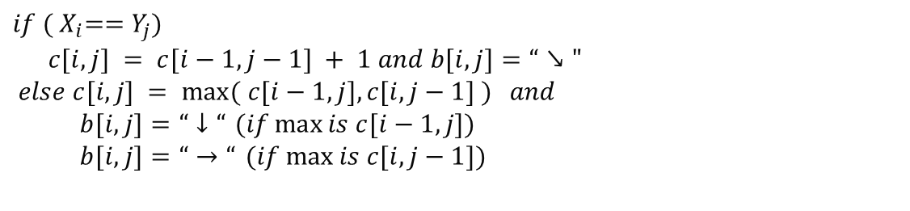
Dynamic Programming
Problem 3: Longest Common Subsequence
Step 3: Compute optimal solution for 0/1 knapsack problem.
Example 1: What do ABCB and BDCAB have in common?
 | j | 0 | 1 | 2 | 3 | 4 | 5
i |  | $$Y_{j}$$ | B | D | C | A | B
0 | $${ X}_{I}$$ | 0 | 0 | 0 | 0 | 0 | 0
1 | A | 0 | 0
2 | B | 0
3 | C | 0
4 | B | 0
$$X = A B C B$$
$$Y = B D C A B$$
$$if ({ X}_{i}=={ Y}_{j})$$
$$c[i,j] = c[i−1,j−1] + 1 and b[i, j]=“↘"$$
$else c[i,j] = max⁡( c[i−1,j], c[i,j−1] )$ $and$
$b[i, j]=“↓“$ $(if\max{is c[i−1,j])}$
$b[i, j]=“→“$ $(if\max{is c[i,j−1])}$

Slide 20
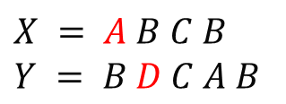
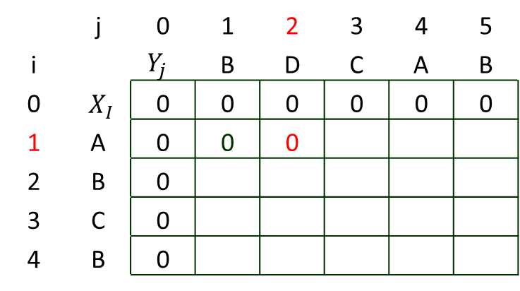
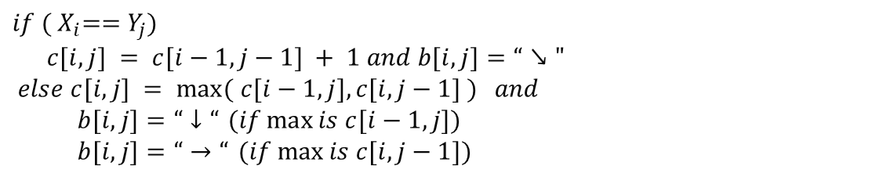
Dynamic Programming
Problem 3: Longest Common Subsequence
Step 3: Compute optimal solution for 0/1 knapsack problem.
Example 1: What do ABCB and BDCAB have in common?
 | j | 0 | 1 | 2 | 3 | 4 | 5
i |  | $$Y_{j}$$ | B | D | C | A | B
0 | $${ X}_{I}$$ | 0 | 0 | 0 | 0 | 0 | 0
1 | A | 0 | 0 | 0
2 | B | 0
3 | C | 0
4 | B | 0
$$X = A B C B$$
$$Y = B D C A B$$
$$if ({ X}_{i}=={ Y}_{j})$$
$$c[i,j] = c[i−1,j−1] + 1 and b[i, j]=“↘"$$
$else c[i,j] = max⁡( c[i−1,j], c[i,j−1] )$ $and$
$b[i, j]=“↓“$ $(if\max{is c[i−1,j])}$
$b[i, j]=“→“$ $(if\max{is c[i,j−1])}$

Slide 21
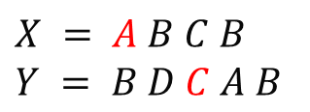
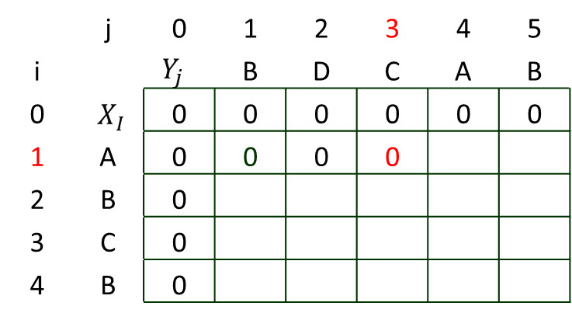
Dynamic Programming
Problem 3: Longest Common Subsequence
Step 3: Compute optimal solution for 0/1 knapsack problem.
Example 1: What do ABCB and BDCAB have in common?
 | j | 0 | 1 | 2 | 3 | 4 | 5
i |  | $$Y_{j}$$ | B | D | C | A | B
0 | $${ X}_{I}$$ | 0 | 0 | 0 | 0 | 0 | 0
1 | A | 0 | 0 | 0 | 0
2 | B | 0
3 | C | 0
4 | B | 0
$$X = A B C B$$
$$Y = B D C A B$$
$$if ({ X}_{i}=={ Y}_{j})$$
$$c[i,j] = c[i−1,j−1] + 1 and b[i, j]=“↘"$$
$else c[i,j] = max⁡( c[i−1,j], c[i,j−1] )$ $and$
$b[i, j]=“↓“$ $(if\max{is c[i−1,j])}$
$b[i, j]=“→“$ $(if\max{is c[i,j−1])}$

Slide 22
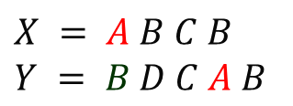
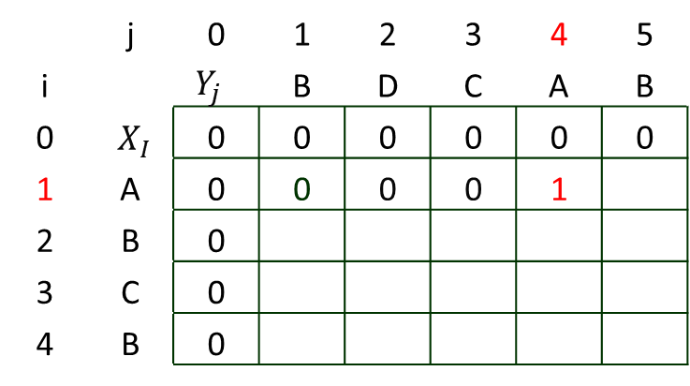
Dynamic Programming
Problem 3: Longest Common Subsequence
Step 3: Compute optimal solution for 0/1 knapsack problem.
Example 1: What do ABCB and BDCAB have in common?
 | j | 0 | 1 | 2 | 3 | 4 | 5
i |  | $$Y_{j}$$ | B | D | C | A | B
0 | $${ X}_{I}$$ | 0 | 0 | 0 | 0 | 0 | 0
1 | A | 0 | 0 | 0 | 0 | 1
2 | B | 0
3 | C | 0
4 | B | 0
$$X = A B C B$$
$$Y = B D C A B$$
$$if ({ X}_{i}=={ Y}_{j})$$
$$c[i,j] = c[i−1,j−1] + 1 and b[i, j]=“↘"$$
$else c[i,j] = max⁡( c[i−1,j], c[i,j−1] )$ $and$
$b[i, j]=“↓“$ $(if\max{is c[i−1,j])}$
$b[i, j]=“→“$ $(if\max{is c[i,j−1])}$

Slide 23
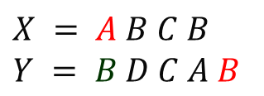
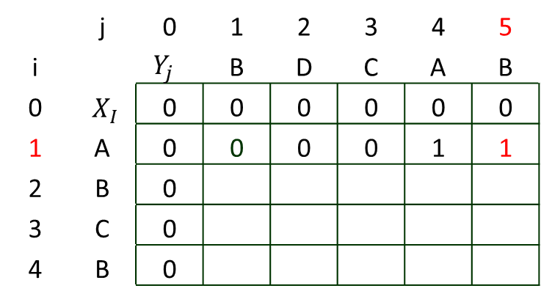
Dynamic Programming
Problem 3: Longest Common Subsequence
Step 3: Compute optimal solution for 0/1 knapsack problem.
Example 1: What do ABCB and BDCAB have in common?
 | j | 0 | 1 | 2 | 3 | 4 | 5
i |  | $$Y_{j}$$ | B | D | C | A | B
0 | $${ X}_{I}$$ | 0 | 0 | 0 | 0 | 0 | 0
1 | A | 0 | 0 | 0 | 0 | 1 | 1
2 | B | 0
3 | C | 0
4 | B | 0
$$X = A B C B$$
$$Y = B D C A B$$
$$if ({ X}_{i}=={ Y}_{j})$$
$$c[i,j] = c[i−1,j−1] + 1 and b[i, j]=“↘"$$
$else c[i,j] = max⁡( c[i−1,j], c[i,j−1] )$ $and$
$b[i, j]=“↓“$ $(if\max{is c[i−1,j])}$
$b[i, j]=“→“$ $(if\max{is c[i,j−1])}$

Slide 24
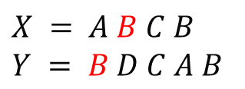
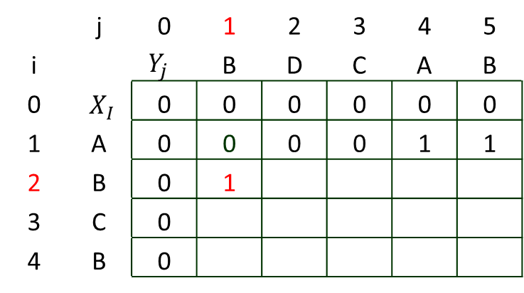
Dynamic Programming
Problem 3: Longest Common Subsequence
Step 3: Compute optimal solution for 0/1 knapsack problem.
Example 1: What do ABCB and BDCAB have in common?
 | j | 0 | 1 | 2 | 3 | 4 | 5
i |  | $$Y_{j}$$ | B | D | C | A | B
0 | $${ X}_{I}$$ | 0 | 0 | 0 | 0 | 0 | 0
1 | A | 0 | 0 | 0 | 0 | 1 | 1
2 | B | 0 | 1
3 | C | 0
4 | B | 0
$$X = A B C B$$
$$Y = B D C A B$$
$$if ({ X}_{i}=={ Y}_{j})$$
$$c[i,j] = c[i−1,j−1] + 1 and b[i, j]=“↘"$$
$else c[i,j] = max⁡( c[i−1,j], c[i,j−1] )$ $and$
$b[i, j]=“↓“$ $(if\max{is c[i−1,j])}$
$b[i, j]=“→“$ $(if\max{is c[i,j−1])}$

Slide 25
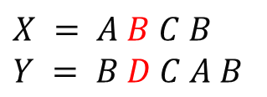
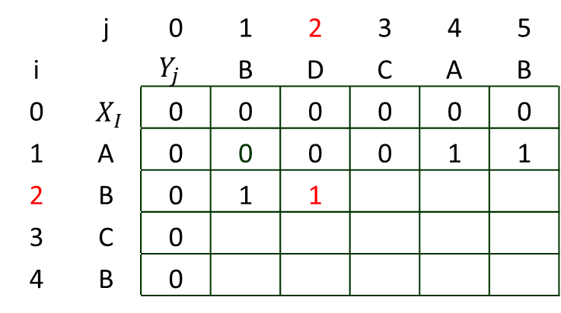
Dynamic Programming
Problem 3: Longest Common Subsequence
Step 3: Compute optimal solution for 0/1 knapsack problem.
Example 1: What do ABCB and BDCAB have in common?
 | j | 0 | 1 | 2 | 3 | 4 | 5
i |  | $$Y_{j}$$ | B | D | C | A | B
0 | $${ X}_{I}$$ | 0 | 0 | 0 | 0 | 0 | 0
1 | A | 0 | 0 | 0 | 0 | 1 | 1
2 | B | 0 | 1 | 1
3 | C | 0
4 | B | 0
$$X = A B C B$$
$$Y = B D C A B$$
$$if ({ X}_{i}=={ Y}_{j})$$
$$c[i,j] = c[i−1,j−1] + 1 and b[i, j]=“↘"$$
$else c[i,j] = max⁡( c[i−1,j], c[i,j−1] )$ $and$
$b[i, j]=“↓“$ $(if\max{is c[i−1,j])}$
$b[i, j]=“→“$ $(if\max{is c[i,j−1])}$

Slide 26
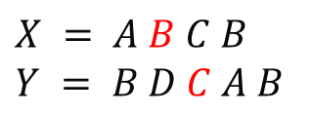
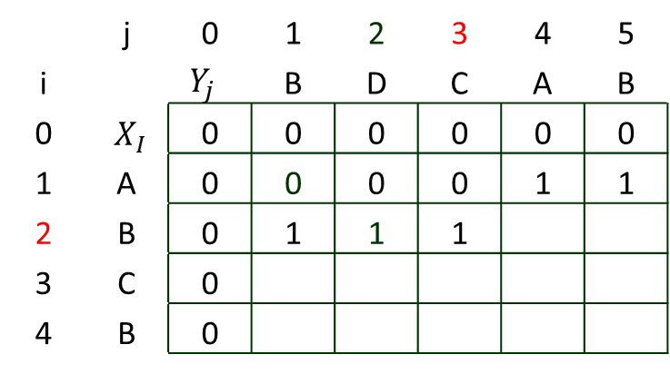
Dynamic Programming
Problem 3: Longest Common Subsequence
Step 3: Compute optimal solution for 0/1 knapsack problem.
Example 1: What do ABCB and BDCAB have in common?
 | j | 0 | 1 | 2 | 3 | 4 | 5
i |  | $$Y_{j}$$ | B | D | C | A | B
0 | $${ X}_{I}$$ | 0 | 0 | 0 | 0 | 0 | 0
1 | A | 0 | 0 | 0 | 0 | 1 | 1
2 | B | 0 | 1 | 1 | 1
3 | C | 0
4 | B | 0
$$X = A B C B$$
$$Y = B D C A B$$
$$if ({ X}_{i}=={ Y}_{j})$$
$$c[i,j] = c[i−1,j−1] + 1 and b[i, j]=“↘"$$
$else c[i,j] = max⁡( c[i−1,j], c[i,j−1] )$ $and$
$b[i, j]=“↓“$ $(if\max{is c[i−1,j])}$
$b[i, j]=“→“$ $(if\max{is c[i,j−1])}$

Slide 27
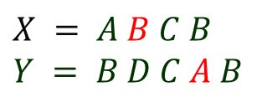
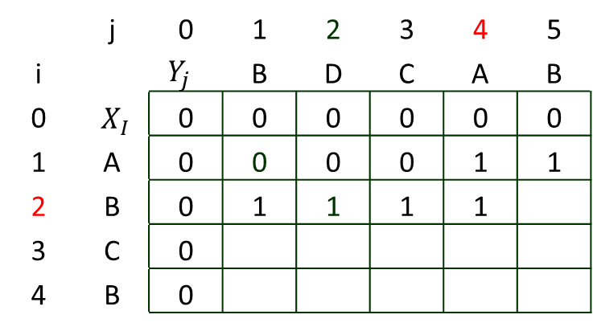
Dynamic Programming
Problem 3: Longest Common Subsequence
Step 3: Compute optimal solution for 0/1 knapsack problem.
Example 1: What do ABCB and BDCAB have in common?
 | j | 0 | 1 | 2 | 3 | 4 | 5
i |  | $$Y_{j}$$ | B | D | C | A | B
0 | $${ X}_{I}$$ | 0 | 0 | 0 | 0 | 0 | 0
1 | A | 0 | 0 | 0 | 0 | 1 | 1
2 | B | 0 | 1 | 1 | 1 | 1
3 | C | 0
4 | B | 0
$$X = A B C B$$
$$Y = B D C A B$$
$$if ({ X}_{i}=={ Y}_{j})$$
$$c[i,j] = c[i−1,j−1] + 1 and b[i, j]=“↘"$$
$else c[i,j] = max⁡( c[i−1,j], c[i,j−1] )$ $and$
$b[i, j]=“↓“$ $(if\max{is c[i−1,j])}$
$b[i, j]=“→“$ $(if\max{is c[i,j−1])}$

Slide 28
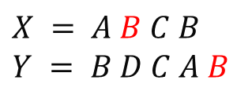
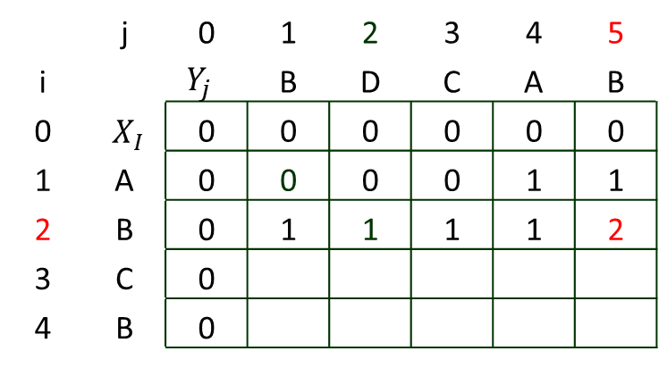
Dynamic Programming
Problem 3: Longest Common Subsequence
Step 3: Compute optimal solution for 0/1 knapsack problem.
Example 1: What do ABCB and BDCAB have in common?
 | j | 0 | 1 | 2 | 3 | 4 | 5
i |  | $$Y_{j}$$ | B | D | C | A | B
0 | $${ X}_{I}$$ | 0 | 0 | 0 | 0 | 0 | 0
1 | A | 0 | 0 | 0 | 0 | 1 | 1
2 | B | 0 | 1 | 1 | 1 | 1 | 2
3 | C | 0
4 | B | 0
$$X = A B C B$$
$$Y = B D C A B$$
$$if ({ X}_{i}=={ Y}_{j})$$
$$c[i,j] = c[i−1,j−1] + 1 and b[i, j]=“↘"$$
$else c[i,j] = max⁡( c[i−1,j], c[i,j−1] )$ $and$
$b[i, j]=“↓“$ $(if\max{is c[i−1,j])}$
$b[i, j]=“→“$ $(if\max{is c[i,j−1])}$

Slide 29
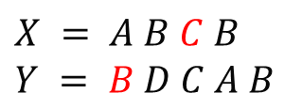
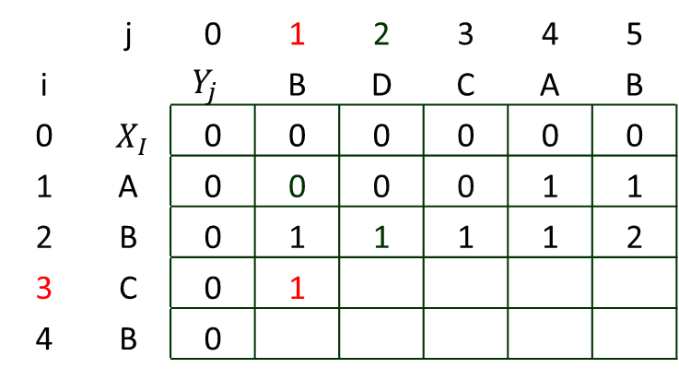
Dynamic Programming
Problem 3: Longest Common Subsequence
Step 3: Compute optimal solution for 0/1 knapsack problem.
Example 1: What do ABCB and BDCAB have in common?
 | j | 0 | 1 | 2 | 3 | 4 | 5
i |  | $$Y_{j}$$ | B | D | C | A | B
0 | $${ X}_{I}$$ | 0 | 0 | 0 | 0 | 0 | 0
1 | A | 0 | 0 | 0 | 0 | 1 | 1
2 | B | 0 | 1 | 1 | 1 | 1 | 2
3 | C | 0 | 1
4 | B | 0
$$X = A B C B$$
$$Y = B D C A B$$
$$if ({ X}_{i}=={ Y}_{j})$$
$$c[i,j] = c[i−1,j−1] + 1 and b[i, j]=“↘"$$
$else c[i,j] = max⁡( c[i−1,j], c[i,j−1] )$ $and$
$b[i, j]=“↓“$ $(if\max{is c[i−1,j])}$
$b[i, j]=“→“$ $(if\max{is c[i,j−1])}$

Slide 30
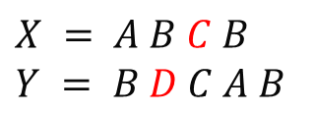
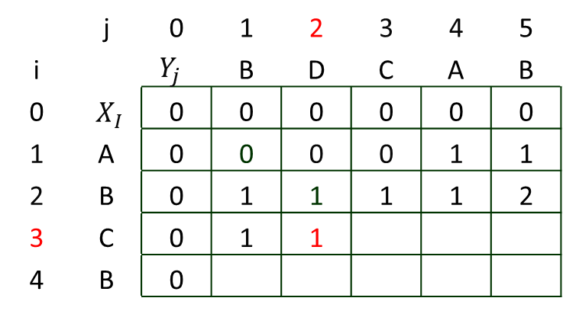
Dynamic Programming
Problem 3: Longest Common Subsequence
Step 3: Compute optimal solution for 0/1 knapsack problem.
Example 1: What do ABCB and BDCAB have in common?
 | j | 0 | 1 | 2 | 3 | 4 | 5
i |  | $$Y_{j}$$ | B | D | C | A | B
0 | $${ X}_{I}$$ | 0 | 0 | 0 | 0 | 0 | 0
1 | A | 0 | 0 | 0 | 0 | 1 | 1
2 | B | 0 | 1 | 1 | 1 | 1 | 2
3 | C | 0 | 1 | 1
4 | B | 0
$$X = A B C B$$
$$Y = B D C A B$$
$$if ({ X}_{i}=={ Y}_{j})$$
$$c[i,j] = c[i−1,j−1] + 1 and b[i, j]=“↘"$$
$else c[i,j] = max⁡( c[i−1,j], c[i,j−1] )$ $and$
$b[i, j]=“↓“$ $(if\max{is c[i−1,j])}$
$b[i, j]=“→“$ $(if\max{is c[i,j−1])}$

Slide 31
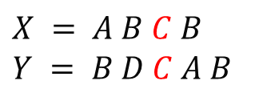
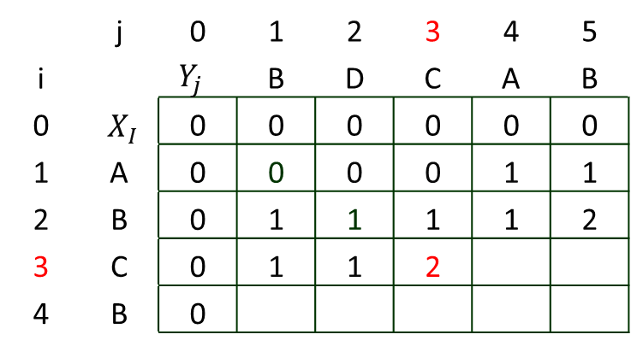
Dynamic Programming
Problem 3: Longest Common Subsequence
Step 3: Compute optimal solution for 0/1 knapsack problem.
Example 1: What do ABCB and BDCAB have in common?
 | j | 0 | 1 | 2 | 3 | 4 | 5
i |  | $$Y_{j}$$ | B | D | C | A | B
0 | $${ X}_{I}$$ | 0 | 0 | 0 | 0 | 0 | 0
1 | A | 0 | 0 | 0 | 0 | 1 | 1
2 | B | 0 | 1 | 1 | 1 | 1 | 2
3 | C | 0 | 1 | 1 | 2
4 | B | 0
$$X = A B C B$$
$$Y = B D C A B$$
$$if ({ X}_{i}=={ Y}_{j})$$
$$c[i,j] = c[i−1,j−1] + 1 and b[i, j]=“↘"$$
$else c[i,j] = max⁡( c[i−1,j], c[i,j−1] )$ $and$
$b[i, j]=“↓“$ $(if\max{is c[i−1,j])}$
$b[i, j]=“→“$ $(if\max{is c[i,j−1])}$

Slide 32
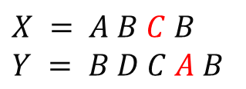
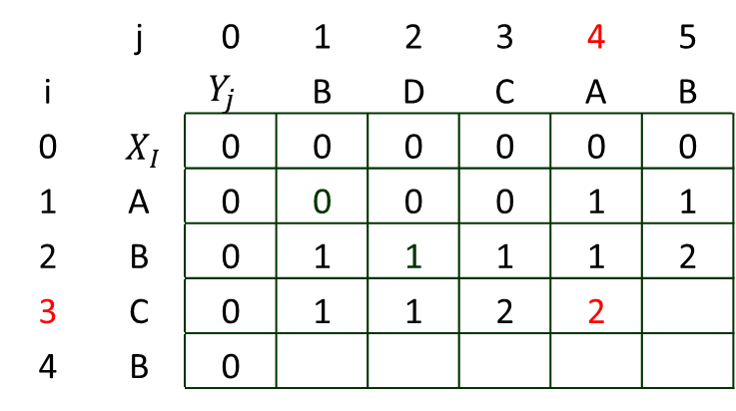
Dynamic Programming
Problem 3: Longest Common Subsequence
Step 3: Compute optimal solution for 0/1 knapsack problem.
Example 1: What do ABCB and BDCAB have in common?
 | j | 0 | 1 | 2 | 3 | 4 | 5
i |  | $$Y_{j}$$ | B | D | C | A | B
0 | $${ X}_{I}$$ | 0 | 0 | 0 | 0 | 0 | 0
1 | A | 0 | 0 | 0 | 0 | 1 | 1
2 | B | 0 | 1 | 1 | 1 | 1 | 2
3 | C | 0 | 1 | 1 | 2 | 2
4 | B | 0
$$X = A B C B$$
$$Y = B D C A B$$
$$if ({ X}_{i}=={ Y}_{j})$$
$$c[i,j] = c[i−1,j−1] + 1 and b[i, j]=“↘"$$
$else c[i,j] = max⁡( c[i−1,j], c[i,j−1] )$ $and$
$b[i, j]=“↓“$ $(if\max{is c[i−1,j])}$
$b[i, j]=“→“$ $(if\max{is c[i,j−1])}$

Slide 33
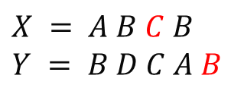
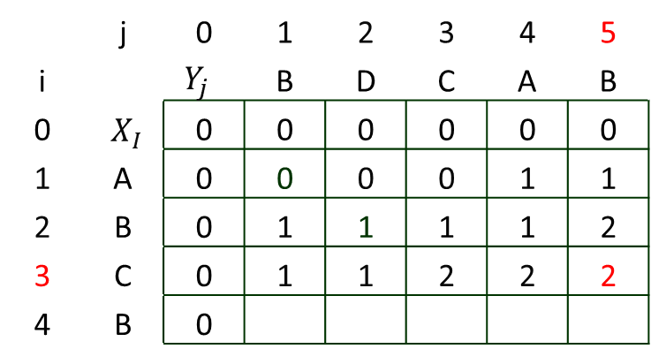
Dynamic Programming
Problem 3: Longest Common Subsequence
Step 3: Compute optimal solution for 0/1 knapsack problem.
Example 1: What do ABCB and BDCAB have in common?
 | j | 0 | 1 | 2 | 3 | 4 | 5
i |  | $$Y_{j}$$ | B | D | C | A | B
0 | $${ X}_{I}$$ | 0 | 0 | 0 | 0 | 0 | 0
1 | A | 0 | 0 | 0 | 0 | 1 | 1
2 | B | 0 | 1 | 1 | 1 | 1 | 2
3 | C | 0 | 1 | 1 | 2 | 2 | 2
4 | B | 0
$$X = A B C B$$
$$Y = B D C A B$$
$$if ({ X}_{i}=={ Y}_{j})$$
$$c[i,j] = c[i−1,j−1] + 1 and b[i, j]=“↘"$$
$else c[i,j] = max⁡( c[i−1,j], c[i,j−1] )$ $and$
$b[i, j]=“↓“$ $(if\max{is c[i−1,j])}$
$b[i, j]=“→“$ $(if\max{is c[i,j−1])}$

Slide 34
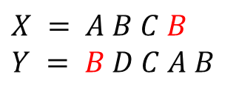
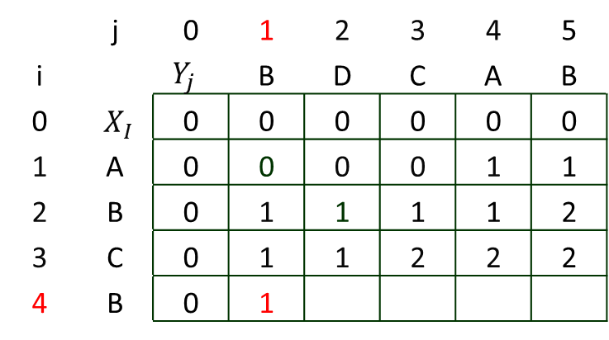
Dynamic Programming
Problem 3: Longest Common Subsequence
Step 3: Compute optimal solution for 0/1 knapsack problem.
Example 1: What do ABCB and BDCAB have in common?
 | j | 0 | 1 | 2 | 3 | 4 | 5
i |  | $$Y_{j}$$ | B | D | C | A | B
0 | $${ X}_{I}$$ | 0 | 0 | 0 | 0 | 0 | 0
1 | A | 0 | 0 | 0 | 0 | 1 | 1
2 | B | 0 | 1 | 1 | 1 | 1 | 2
3 | C | 0 | 1 | 1 | 2 | 2 | 2
4 | B | 0 | 1
$$X = A B C B$$
$$Y = B D C A B$$
$$if ({ X}_{i}=={ Y}_{j})$$
$$c[i,j] = c[i−1,j−1] + 1 and b[i, j]=“↘"$$
$else c[i,j] = max⁡( c[i−1,j], c[i,j−1] )$ $and$
$b[i, j]=“↓“$ $(if\max{is c[i−1,j])}$
$b[i, j]=“→“$ $(if\max{is c[i,j−1])}$

Slide 35
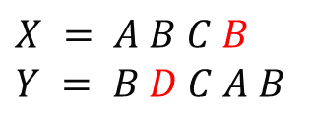
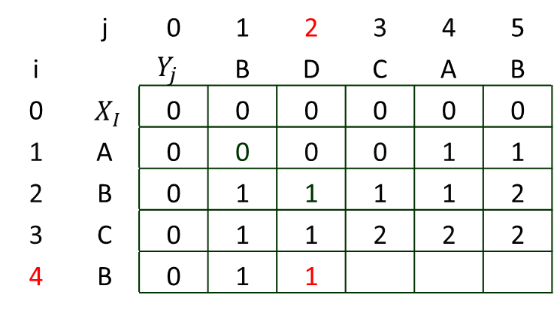
Dynamic Programming
Problem 3: Longest Common Subsequence
Step 3: Compute optimal solution for 0/1 knapsack problem.
Example 1: What do ABCB and BDCAB have in common?
 | j | 0 | 1 | 2 | 3 | 4 | 5
i |  | $$Y_{j}$$ | B | D | C | A | B
0 | $${ X}_{I}$$ | 0 | 0 | 0 | 0 | 0 | 0
1 | A | 0 | 0 | 0 | 0 | 1 | 1
2 | B | 0 | 1 | 1 | 1 | 1 | 2
3 | C | 0 | 1 | 1 | 2 | 2 | 2
4 | B | 0 | 1 | 1
$$X = A B C B$$
$$Y = B D C A B$$
$$if ({ X}_{i}=={ Y}_{j})$$
$$c[i,j] = c[i−1,j−1] + 1 and b[i, j]=“↘"$$
$else c[i,j] = max⁡( c[i−1,j], c[i,j−1] )$ $and$
$b[i, j]=“↓“$ $(if\max{is c[i−1,j])}$
$b[i, j]=“→“$ $(if\max{is c[i,j−1])}$

Slide 36
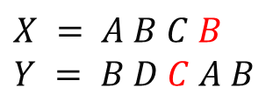
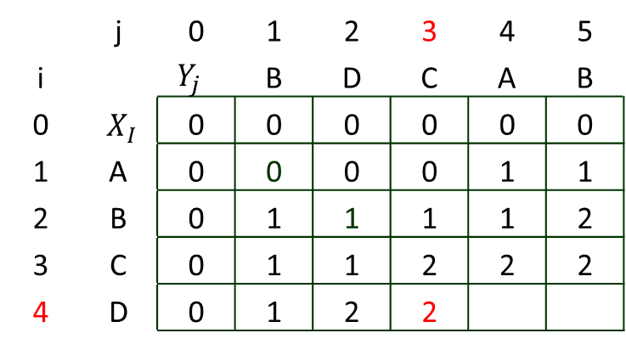
Dynamic Programming
Problem 3: Longest Common Subsequence
Step 3: Compute optimal solution for 0/1 knapsack problem.
Example 1: What do ABCB and BDCAB have in common?
 | j | 0 | 1 | 2 | 3 | 4 | 5
i |  | $$Y_{j}$$ | B | D | C | A | B
0 | $${ X}_{I}$$ | 0 | 0 | 0 | 0 | 0 | 0
1 | A | 0 | 0 | 0 | 0 | 1 | 1
2 | B | 0 | 1 | 1 | 1 | 1 | 2
3 | C | 0 | 1 | 1 | 2 | 2 | 2
4 | D | 0 | 1 | 2 | 2
$$X = A B C B$$
$$Y = B D C A B$$
$$if ({ X}_{i}=={ Y}_{j})$$
$$c[i,j] = c[i−1,j−1] + 1 and b[i, j]=“↘"$$
$else c[i,j] = max⁡( c[i−1,j], c[i,j−1] )$ $and$
$b[i, j]=“↓“$ $(if\max{is c[i−1,j])}$
$b[i, j]=“→“$ $(if\max{is c[i,j−1])}$

Slide 37
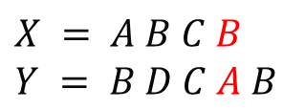

Dynamic Programming
Problem 3: Longest Common Subsequence
Step 3: Compute optimal solution for 0/1 knapsack problem.
Example 1: What do ABCB and BDCAB have in common?
 | j | 0 | 1 | 2 | 3 | 4 | 5
i |  | $$Y_{j}$$ | B | D | C | A | B
0 | $${ X}_{I}$$ | 0 | 0 | 0 | 0 | 0 | 0
1 | A | 0 | 0 | 0 | 0 | 1 | 1
2 | B | 0 | 1 | 1 | 1 | 1 | 2
3 | C | 0 | 1 | 1 | 2 | 2 | 2
4 | B | 0 | 1 | 1 | 2 | 2
$$X = A B C B$$
$$Y = B D C A B$$
$$if ({ X}_{i}=={ Y}_{j})$$
$$c[i,j] = c[i−1,j−1] + 1 and b[i, j]=“↘"$$
$else c[i,j] = max⁡( c[i−1,j], c[i,j−1] )$ $and$
$b[i, j]=“↓“$ $(if\max{is c[i−1,j])}$
$b[i, j]=“→“$ $(if\max{is c[i,j−1])}$

Slide 38


Dynamic Programming
Problem 3: Longest Common Subsequence
Step 3: Compute optimal solution for 0/1 knapsack problem.
Example 1: What do ABCB and BDCAB have in common?
 | j | 0 | 1 | 2 | 3 | 4 | 5
i |  | $$Y_{j}$$ | B | D | C | A | B
0 | $${ X}_{I}$$ | 0 | 0 | 0 | 0 | 0 | 0
1 | A | 0 | 0 | 0 | 0 | 1 | 1
2 | B | 0 | 1 | 1 | 1 | 1 | 2
3 | C | 0 | 1 | 1 | 2 | 2 | 2
4 | B | 0 | 1 | 1 | 2 | 2 | 3
$$X = A B C B$$
$$Y = B D C A B$$
$$if ({ X}_{i}=={ Y}_{j})$$
$$c[i,j] = c[i−1,j−1] + 1 and b[i, j]=“↘"$$
$else c[i,j] = max⁡( c[i−1,j], c[i,j−1] )$ $and$
$b[i, j]=“↓“$ $(if\max{is c[i−1,j])}$
$b[i, j]=“→“$ $(if\max{is c[i,j−1])}$

Slide 39
Dynamic Programming
Problem 3: Longest Common Subsequence
Step 3: Compute optimal solution for 0/1 knapsack problem.
Example 1: What do ABCB and BDCAB have in common?
 | j | 0 | 1 | 2 | 3 | 4 | 5
i |  | $$Y_{j}$$ | B | D | C | A | B
0 | $${ X}_{I}$$ | 0 | 0 | 0 | 0 | 0 | 0
1 | A | 0 | 0 | 0 | 0 | 1 | 1
2 | B | 0 | 1 | 1 | 1 | 1 | 2
3 | C | 0 | 1 | 1 | 2 | 2 | 2
4 | B | 0 | 1 | 1 | 2 | 2 | 3
$$X = A B C B$$
$$Y = B D C A B$$
$$if ({ X}_{i}=={ Y}_{j})$$
$$c[i,j] = c[i−1,j−1] + 1 and b[i, j]=“↘"$$
$else c[i,j] = max⁡( c[i−1,j], c[i,j−1] )$ $and$
$b[i, j]=“↓“$ $(if\max{is c[i−1,j])}$
$b[i, j]=“→“$ $(if\max{is c[i,j−1])}$

Slide 40

Dynamic Programming
Problem 3: Longest Common Subsequence
Step 3: Compute optimal solution for 0/1 knapsack problem.
Example 1: What do ABCB and BDCAB have in common?
 | j | 0 | 1 | 2 | 3 | 4 | 5
i |  | $$Y_{j}$$ | B | D | C | A | B
0 | $${ X}_{I}$$ | 0 | 0 | 0 | 0 | 0 | 0
1 | A | 0 | 0 | 0 | 0 | 1 | 1
2 | B | 0 | 1 | 1 | 1 | 1 | 2
3 | C | 0 | 1 | 1 | 2 | 2 | 2
4 | B | 0 | 1 | 1 | 2 | 2 | 3
$$X = A B C B$$
$$Y = B D C A B$$
The running time= $O(m∗n)$
since each $c[i,j]$ is calculated in constant time, and there are m*n elements in the array
$$if ({ X}_{i}=={ Y}_{j})$$
$$c[i,j] = c[i−1,j−1] + 1 and b[i, j]=“↘"$$
$else c[i,j] = max⁡( c[i−1,j], c[i,j−1] )$ $and$
$b[i, j]=“↓“$ $(if\max{is c[i−1,j])}$
$b[i, j]=“→“$ $(if\max{is c[i,j−1])}$

Slide 41

Dynamic Programming
Problem 3: Longest Common Subsequence
Step 4: Construct / print the optimal solution of 0/1 knapsack problem.
Example 1: What do ABCB and BDCAB have in common?
$$Print−LCS(b,X,i,j)$$
$$if\left(i==0\right)and \left(j==0\right)$$
$$return$$
$$if b\left[i,j\right]==“↘“$$
$Print−LCS(b,X,i−1,j−1)$
$$if b\left[i,j\right]==“↓“$$
$Print−LCS(b,X,i−1,j)$
$$elsePrint−LCS(b,X,i,j−1)$$

Slide 42



Dynamic Programming
Problem 3: Longest Common Subsequence
Step 4: Construct / print the optimal solution of 0/1 knapsack problem.
Example 1: What do ABCB and BDCAB have in common?
 | j | 0 | 1 | 2 | 3 | 4 | 5
i |  | $$Y_{j}$$ | B | D | C | A | B
0 | $${ X}_{I}$$ | 0 | 0 | 0 | 0 | 0 | 0
1 | A | 0 | 0 | 0 | 0 | 1 | 1
2 | B | 0 | 1 | 1 | 1 | 1 | 2
3 | C | 0 | 1 | 1 | 2 | 2 | 2
4 | B | 0 | 1 | 1 | 2 | 2 | 3
$$Print−LCS(b,X,i,j)$$
$$if\left(i==0\right)and \left(j==0\right)$$
$$return$$
$$if b\left[i,j\right]==“↘“$$
$Print−LCS(b,X,i−1,j−1)$
$$if b\left[i,j\right]==“↓“$$
$Print−LCS(b,X,i−1,j)$
$$elsePrint−LCS(b,X,i,j−1)$$
$$B$$

Slide 43


Dynamic Programming
Problem 3: Longest Common Subsequence
Step 4: Construct / print the optimal solution of 0/1 knapsack problem.
Example 1: What do ABCB and BDCAB have in common?
 | j | 0 | 1 | 2 | 3 | 4 | 5
i |  | $$Y_{j}$$ | B | D | C | A | B
0 | $${ X}_{I}$$ | 0 | 0 | 0 | 0 | 0 | 0
1 | A | 0 | 0 | 0 | 0 | 1 | 1
2 | B | 0 | 1 | 1 | 1 | 1 | 2
3 | C | 0 | 1 | 1 | 2 | 2 | 2
4 | B | 0 | 1 | 1 | 2 | 2 | 3
$$Print−LCS(b,X,i,j)$$
$$if\left(i==0\right)and \left(j==0\right)$$
$$return$$
$$if b\left[i,j\right]==“↘“$$
$Print−LCS(b,X,i−1,j−1)$
$$if b\left[i,j\right]==“↓“$$
$Print−LCS(b,X,i−1,j)$
$$elsePrint−LCS(b,X,i,j−1)$$
$C B$

Slide 44


Dynamic Programming
Problem 3: Longest Common Subsequence
Step 4: Construct / print the optimal solution of 0/1 knapsack problem.
Example 1: What do ABCB and BDCAB have in common?
 | j | 0 | 1 | 2 | 3 | 4 | 5
i |  | $$Y_{j}$$ | B | D | C | A | B
0 | $${ X}_{I}$$ | 0 | 0 | 0 | 0 | 0 | 0
1 | A | 0 | 0 | 0 | 0 | 1 | 1
2 | B | 0 | 1 | 1 | 1 | 1 | 2
3 | C | 0 | 1 | 1 | 2 | 2 | 2
4 | B | 0 | 1 | 1 | 2 | 2 | 3
$$Print−LCS(b,X,i,j)$$
$$if\left(i==0\right)and \left(j==0\right)$$
$$return$$
$$if b\left[i,j\right]==“↘“$$
$Print−LCS(b,X,i−1,j−1)$
$$if b\left[i,j\right]==“↓“$$
$Print−LCS(b,X,i−1,j)$
$$elsePrint−LCS(b,X,i,j−1)$$
$$B C B$$

Slide 45
Dynamic Programming
Problem 3: Longest Common Subsequence
Step 4: Construct / print the optimal solution of 0/1 knapsack problem.
Example 1: What do ABCB and BDCAB have in common?
 | j | 0 | 1 | 2 | 3 | 4 | 5
i |  | $$Y_{j}$$ | B | D | C | A | B
0 | $${ X}_{I}$$ | 0 | 0 | 0 | 0 | 0 | 0
1 | A | 0 | 0 | 0 | 0 | 1 | 1
2 | B | 0 | 1 | 1 | 1 | 1 | 2
3 | C | 0 | 1 | 1 | 2 | 2 | 2
4 | B | 0 | 1 | 1 | 2 | 2 | 3
$$Print−LCS(b,X,i,j)$$
$$if\left(i==0\right)and \left(j==0\right)$$
$$return$$
$$if b\left[i,j\right]==“↘“$$
$Print−LCS(b,X,i−1,j−1)$
$$if b\left[i,j\right]==“↓“$$
$Print−LCS(b,X,i−1,j)$
$$elsePrint−LCS(b,X,i,j−1)$$
$$print reverse(B C B)= B C B$$

Slide 46


Dynamic Programming
Problem 3: Longest Common Subsequence
Step 4: Construct / print the optimal solution of 0/1 knapsack problem.
Example 1: What do ABCB and BDCAB have in common?
$$Print−LCS(b,X,i,j)$$
$$if\left(i==0\right)and \left(j==0\right)$$
$$return$$
$$if b\left[i,j\right]==“↘“$$
$Print−LCS(b,X,i−1,j−1)$
$$if b\left[i,j\right]==“↓“$$
$Print−LCS(b,X,i−1,j)$
$$elsePrint−LCS(b,X,i,j−1)$$
This algorithm required $Θ(m+n)$ time for execution

Slide 47

Dynamic Programming
Problem 3: Longest Common Subsequence
Example 2: What do ABCBDAB and BDCABA have in common?
$$X = A B C B D A B$$
$$Y = B D C A B A$$
What is the Longest Common Subsequence $LCS (X, Y)$?
Example 3: What do AGGTA and GXTYAY have in common?
$$X = A G G T A$$
$$Y =G X T Y A Y$$
What is the Longest Common Subsequence $LCS (X, Y)$?
.
Self practice

Slide 48

Thank U

